Slide 1
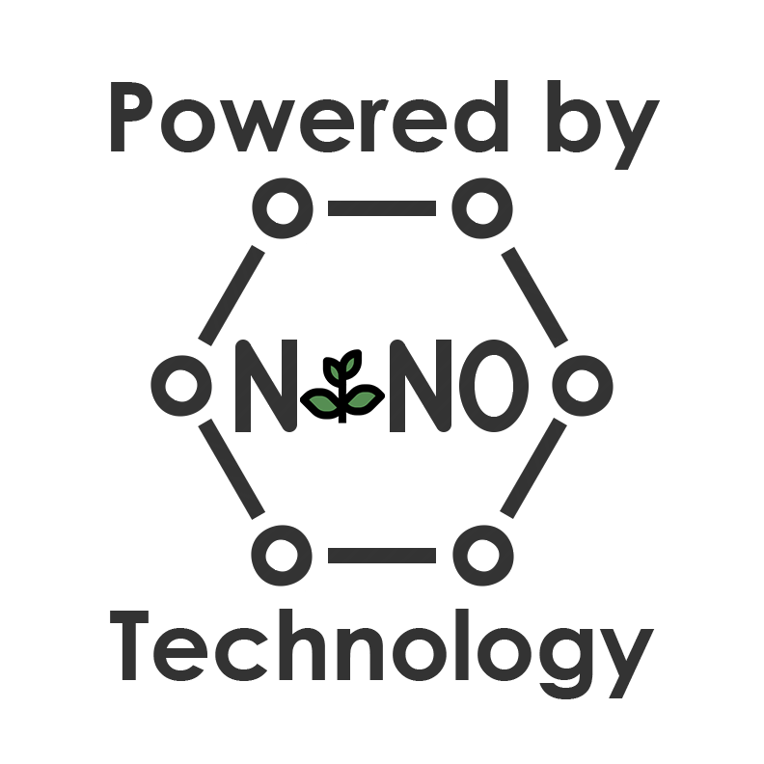
Making plants stronger than chemicals.
Franco Lepiane
514.465.6475
info@bionanoproducts.com

Slide 2
FORMULA OVERVIEW New Innovation In Nanotechnology
Bionano is a unique, proprietary blend of sustainable, plant-derived ingredients that are:
All-Natural
Non-Toxic
Biodegradable
Non-Fuming
Non-Caustic
Non-Flammable
Non-Hazardous
REMOVE CHEMICALS, WAX, AND DIRT !
hypo-allergenic.
residue free.
tasteless.
safe.
bio-based.
non-toxic
514.465.6475 • BIONANO • info@bionanoproducts.com

Slide 3
What makes Bionano work so much better than conventional products?
SUPER SURFACE-ACTIVITY
A specialized chemical reaction produces super surface-active amphiphilic molecules (can mix with both oil and water).
Compared to traditional surfactants, Bionano has significantly higher surface-activity due to its unique natural enzymes.
When Bionano is applied to grease and oil contaminants, its micellar nanoparticles automatically dissociate.
Structurally similar to traditional soap and detergent molecules, with one exception, they operate at the nanoscale.
NON
TOXIC
hypo-allergenic.
residue free.
tasteless.
safe.
bio-based.
non-toxic
514.465.6475 • BIONANO • info@bionanoproducts.com

Slide 4
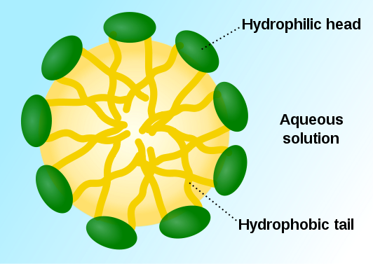
How does Bionano NTS Work?
Product of Biomolecular Nanotechnology.
A unique combination of all-natural ingredients mixed using a proprietary process.
Nanoparticles have a water-attractive (hydrophilic) head and an oil-attractive (hydrophobic) tail. The tails immediately attract oil and grease molecules and leave the water-attractive head outside. The heads are completely surrounded by water molecules and bond with them.
When flushed with water, the trapped oil and grease molecules are completely dissolved and removed as a biodegradable residue.
Penetrate and rupture cell walls of bacteria, viruses and mold spores (e.g. e. coli and salmonella bacteria).
hypo-allergenic.
residue free.
tasteless.
safe.
bio-based.
non-toxic
514.465.6475 • BIONANO • info@bionanoproducts.com

Slide 5
What makes Bionano the Greenest product on the planet?
Sourced from 100% all-natural, plant-derived, sustainable raw ingredients.
Energy- and resource-efficient manufacturing process with low environmental impact.
One formula replaces nearly all other cleaning products (with more products to come).
Decontaminates toxic chemicals, kills germs, and repels insects.
Bionano NTS DOES NOT contain: Chlorine; Ammonia; VOCs; SVOCs; POMs; Biocides; Pyrethroids; NPEs; PCBs; PAHs; Organophosphates; Phthalates. It is as safe as drinkable water.
All Bionano NTS ingredients meet criteria for the US EPA Design for the Environment Program (DfE)/Safer Detergents Stewardship Initiative (SDSI). Ingredients do not appear on the California Proposition 65 or Canadian CEPA-DSL lists.
Absolutely nontoxic and harmless to humans and animals. 10 times safer to aquatic life than conventional detergents.
Allergic and chemically sensitive people can use it with complete confidence and safety. Today, simply being green isn’t enough anymore. Consumers are becoming more willing to know why products work (or not).
hypo-allergenic.
residue free.
tasteless.
safe.
bio-based.
non-toxic
514.465.6475 • BIONANO • info@bionanoproducts.com

Slide 6
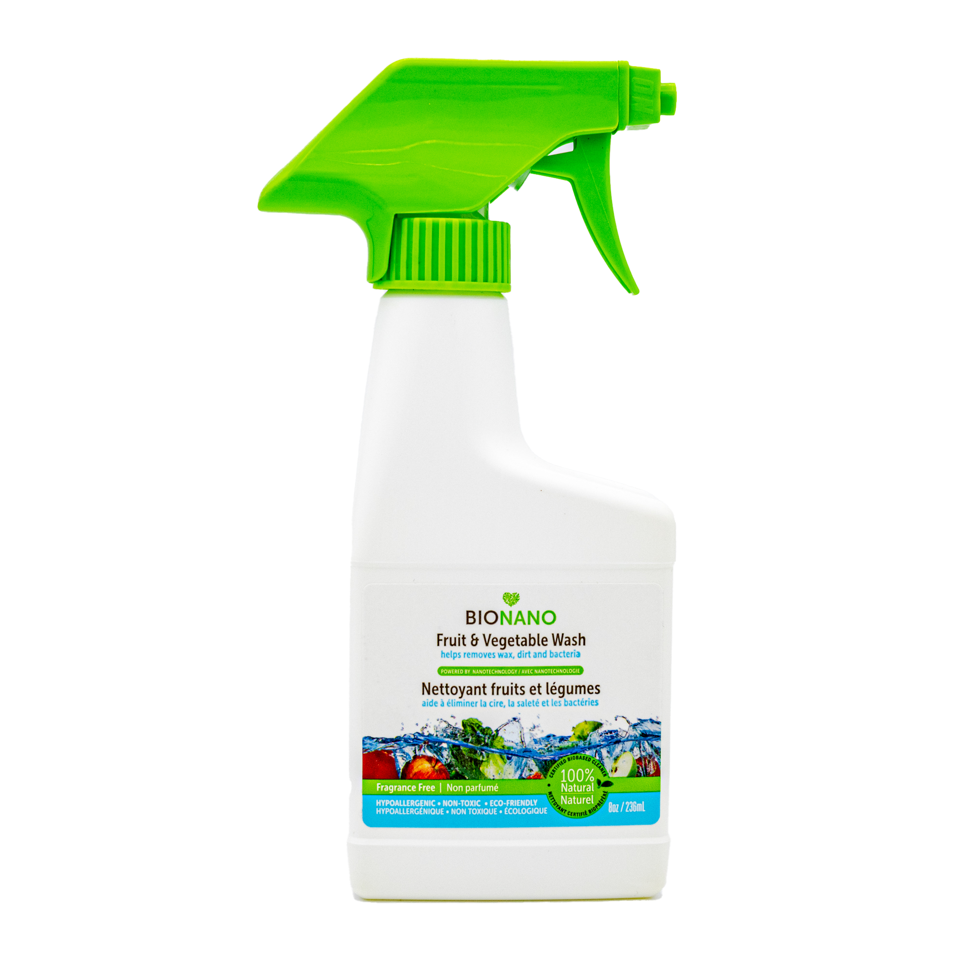
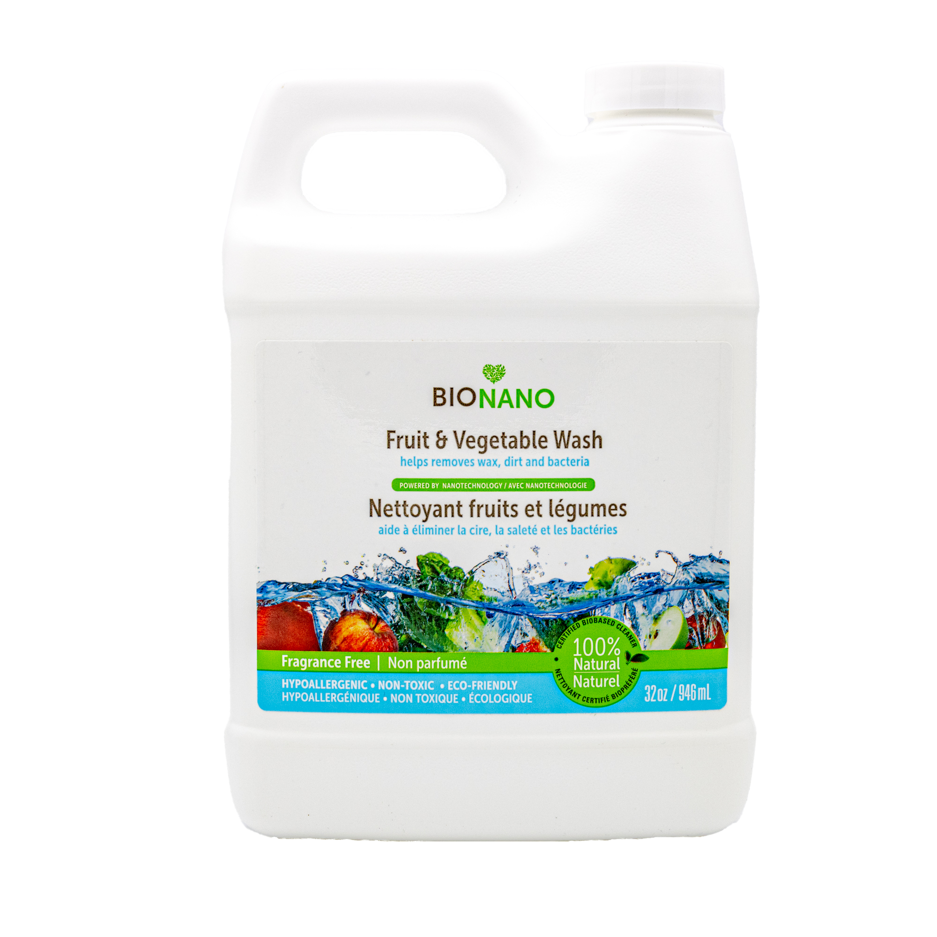
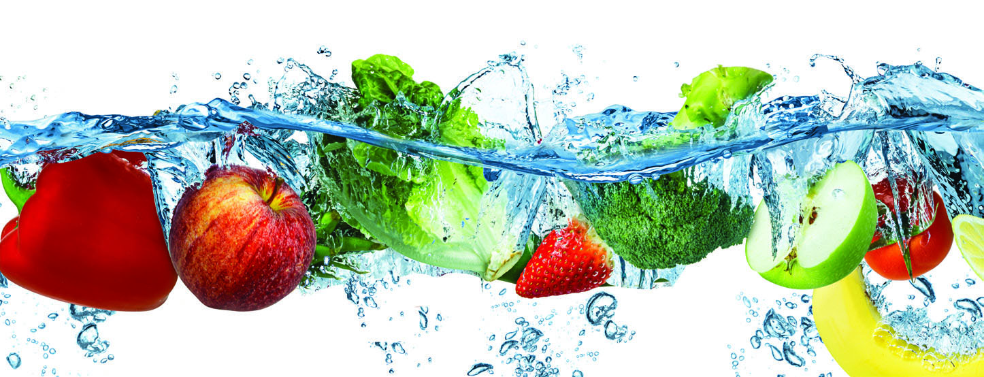
INTRODUCING BIONANO’S FRUIT & VEGETABLE WASH
hypo-allergenic.
residue free.
tasteless.
safe.
bio-based.
non-toxic
514.465.6475 • BIONANO • info@bionanoproducts.com

Slide 7
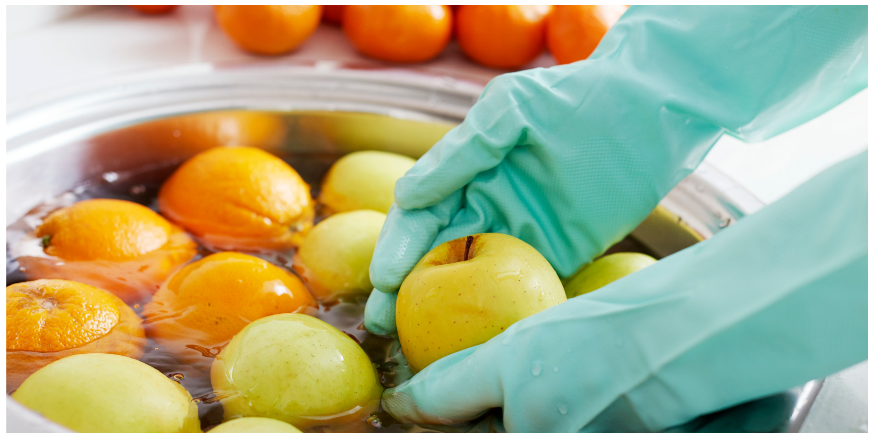
Bionano is a100% safe solution for YOUR FAMILY!
Fruits and vegetables are coated with toxic waterproof substances designed to withstand rain or irrigation. Washing your vegetables with BIONANO's Fruit & Vegetable Wash is an extra measure that prevents food-borne illnesses, including those caused by bacteria and viruses such as salmonella, listeria, e. coli, etc.
In addition, washing vegetables can eliminate any residue left by harmful pesticides. BIONANO's Fruit & Vegetable Wash is made of bio-based and non-toxic ingredients that will not harm your immune system, or the environment.
Bionano is able to achieve this due to the power of nanotechnology.
hypo-allergenic.
residue free.
tasteless.
safe.
bio-based.
non-toxic
514.465.6475 • BIONANO • info@bionanoproducts.com

Slide 8
Our Competition
Some “Green” cleaners are nontoxic but are not very effective.
Most cleaners have single or limited applications
Bionano’s competitive advantage comes from the fact that we utilize the power of nanotechnology, which allows our formula to penetrate and rupture cell walls of bacteria, viruses and mold spores.
 | Conventional Toxic Cleaners | Eco-Friendly “Green” Cleaners | Bionano NTS
100% Non-Toxic | NO | Sometimes | YES
Readily Biodegradable | NO | YES | YES
Industrial Strength | YES | NO | YES
Multi-Purpose | Sometimes | Sometimes | YES
Cost Effective | Sometimes | Sometimes | YES
hypo-allergenic.
residue free.
tasteless.
safe.
bio-based.
non-toxic
514.465.6475 • BIONANO • info@bionanoproducts.com

Slide 9
Our Competition (cont.)
Our cleanest competitors:
Nellie's Fruit & Veggie Wash: contains phenoxyethanol which the FDA stated can cause the shut down of the central nervous system, vomiting, and contact dermatitis.
Attitude Nature+ Fruit & Vegetables Wash
Ecomax Fruit & Veggie Wash
Nature Clean Veggie Wash: Natural Veggie Wash
Rebel Clean Fruit & Veggie Wash (not promoted as hypoallergenic, biodegradable, cruelty-free)
Although being green is an attractive selling point, it is not enough. There is a fine balance between being green and product performance. Given today’s realities of COVID-19, eliminating ingestible toxins is a must but not at the cost of product performance. With Bionano, there’s no need to sacrifice either.
These competitors all have near identical ingredients but they do not explain why/if they work. For example; Economax’s site states that “this product does not have extended information available as no standardized tests have been established” whereas Bionano has been testing* our solution since 2008.
* Testing includes efficacy, bacterial, fungal and viricidal testing as well as toxicity and cleaning reports.
hypo-allergenic.
residue free.
tasteless.
safe.
bio-based.
non-toxic
514.465.6475 • BIONANO • info@bionanoproducts.com

Slide 10
Thank You!
hypo-allergenic.
residue free.
tasteless.
safe.
bio-based.
non-toxic
514.465.6475 • BIONANO • info@bionanoproducts.com

